Slide 1

HEADS UP!
✨AI Generated
We know when you are zoned out
Green Team: Alessandro Monni, Daniele Nicoletti, Leonardo Picchiami, Philip Wiese
Notes:
hello, we are the green team, I am alessandro, he is daniele, leonardo and philip, and as you can read in the title slide our creative lab project is called heads up!

Slide 2




ALESSANDRO
DANIELE
TEAM MEMBERS
LEONARDO
PHILIP
CEO
Researcher on Power Point field
Caffeine Enthusiast Officer
Basically the Team Manager
Just the GOD
1
Notes:
First of all, I would like to quickly introduce the group, taking the opportunity to thank my mates

Slide 3
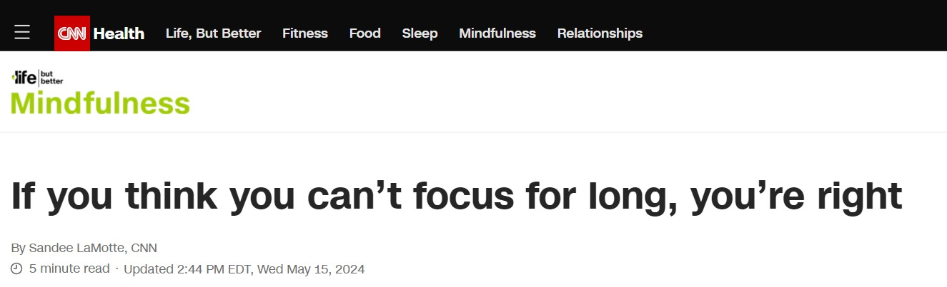

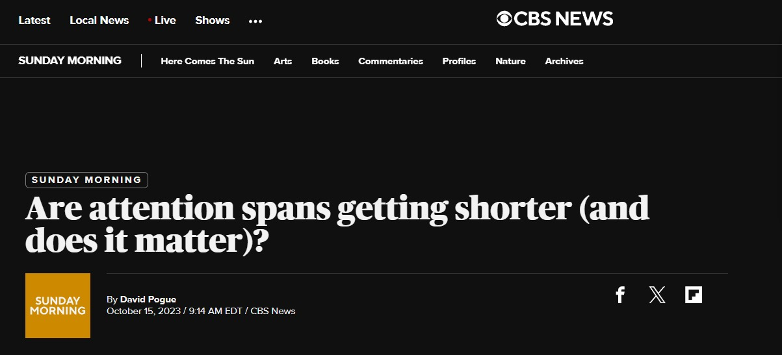

INTRODUCTION
2
Notes:
okay, let's start presenting the problem that lead us to develop this creative lab project,
Today people’s and especially student’s attention span is very feeble and short.
here we have some titles from very famous newspapers around the world, such as the cnn, the guardian, cbs news and the new York post that shows how the problem is widespread

Slide 4
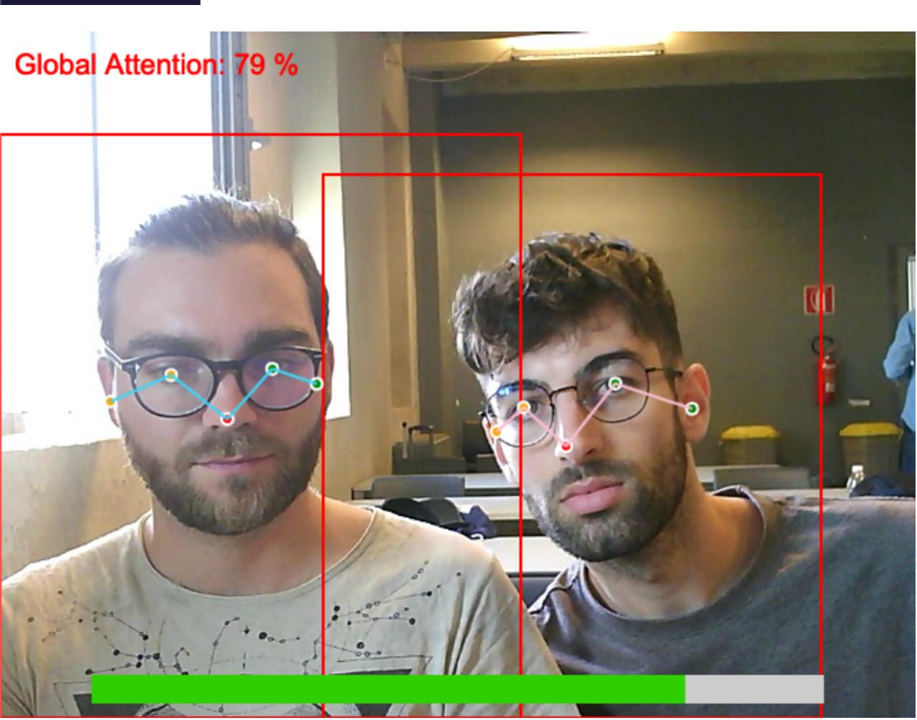
Our Solution
Pose-based human attention estimation system
3
Notes:
So basically our solution is a pose-based human attention estimation system as you can see here

Slide 5
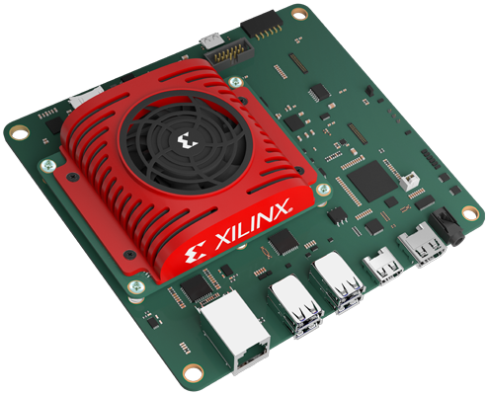
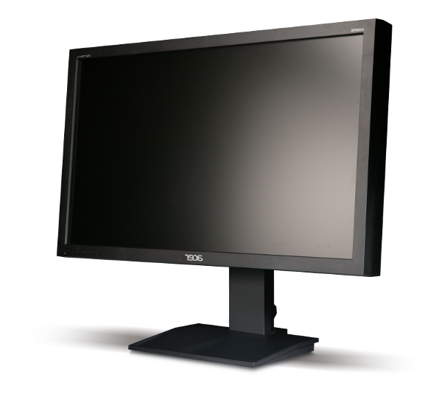
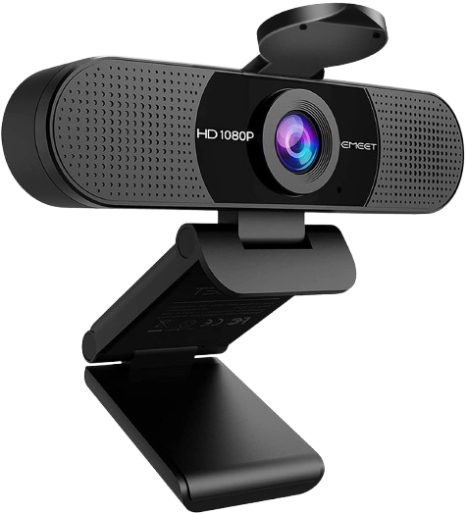


PIPELINE
On-Board computation
On-Server computation
Persons = detect_person(img)
Person detection
avg_att /= lenght(persons)
camera = new.camera()
img = camera.capture_image()
Image capturing
Average
attention
Pose estimation
Attention computation
for p in persons {
pose = extimate_pose(p)
poses.append(pose)
}
for pose in poses {
att = compute_attention(pose)
att_sum += att
}
4
Notes:
now let's talk about the implementation, so we start by capturing the image of the audience through the webcam, after which the fpga recognizes the people, the data is sent to a local server.the server estimates the pose and calculates the attention of each participant and then calculates the average global audience attention

Slide 6
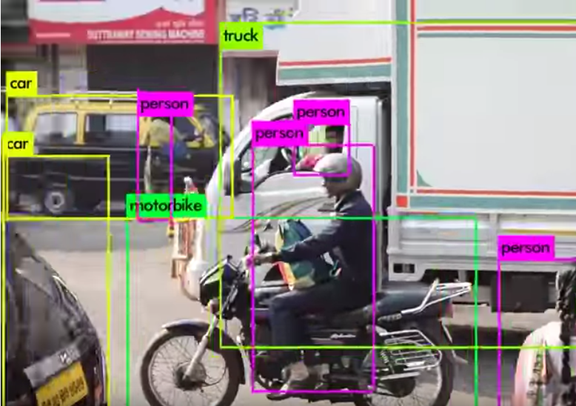
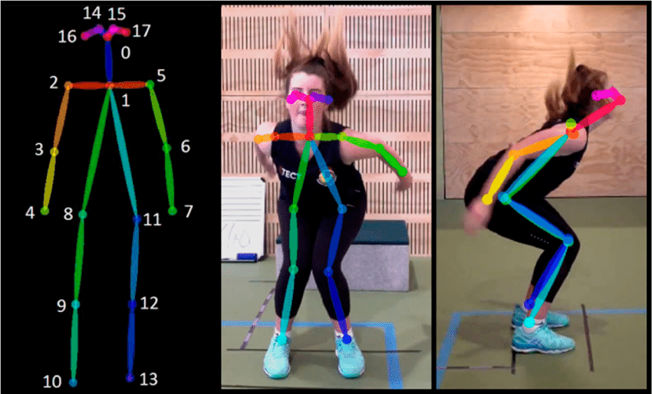
YOLO v3
AI MODELS
Movenet
Object Detection CNN
Human body estimation model
5
Notes:
person recognition is performed through the cnn yolov3 which recognizes objects, subsequently filtered by the label
pose estimation, on the other hand, is performed through the movenet neural network

Slide 7
Improve attention detection
FUTURE WORKS
All on board!
Feedback report
Virtual Reality
The system will be integrated with virtual reality technology to provide a real time information on the attention level of the audience
We will improve the attention detection algorithm by using additional informations from the pose estimator
Security Improvement
In order to protect people images and data
All the pipeline will be integrated on the Kria
Which topic is causing attention reduction
7
Notes:
To conclude, some future extensions of this for this project could be the followings.
First of all we want to improve the attention detection algorithm to increase the accuracy of the estimate
Then we are planning to move all the

Slide 8

THANKS !
Does anyone have any questions?
https://x.com/CPSschool20
https://www.linkedin.com/in/cps-summer-school-840703240/
9

